Slide 1
GEC 2026 Programming
Tiny Joes
John Mclean & Noah Harris-Lowe

Slide 2
Table of Contents
Problem & Objective
Program
Demonstration
Implementation
Challenges
Future Plans

Slide 3
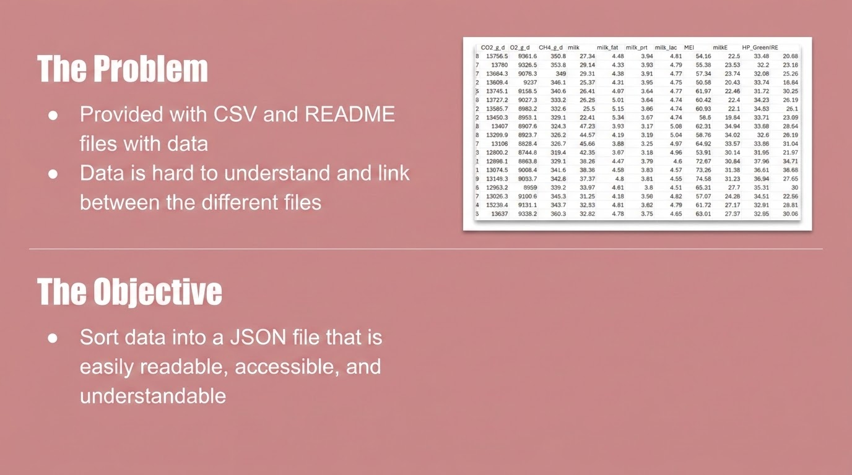

Slide 4
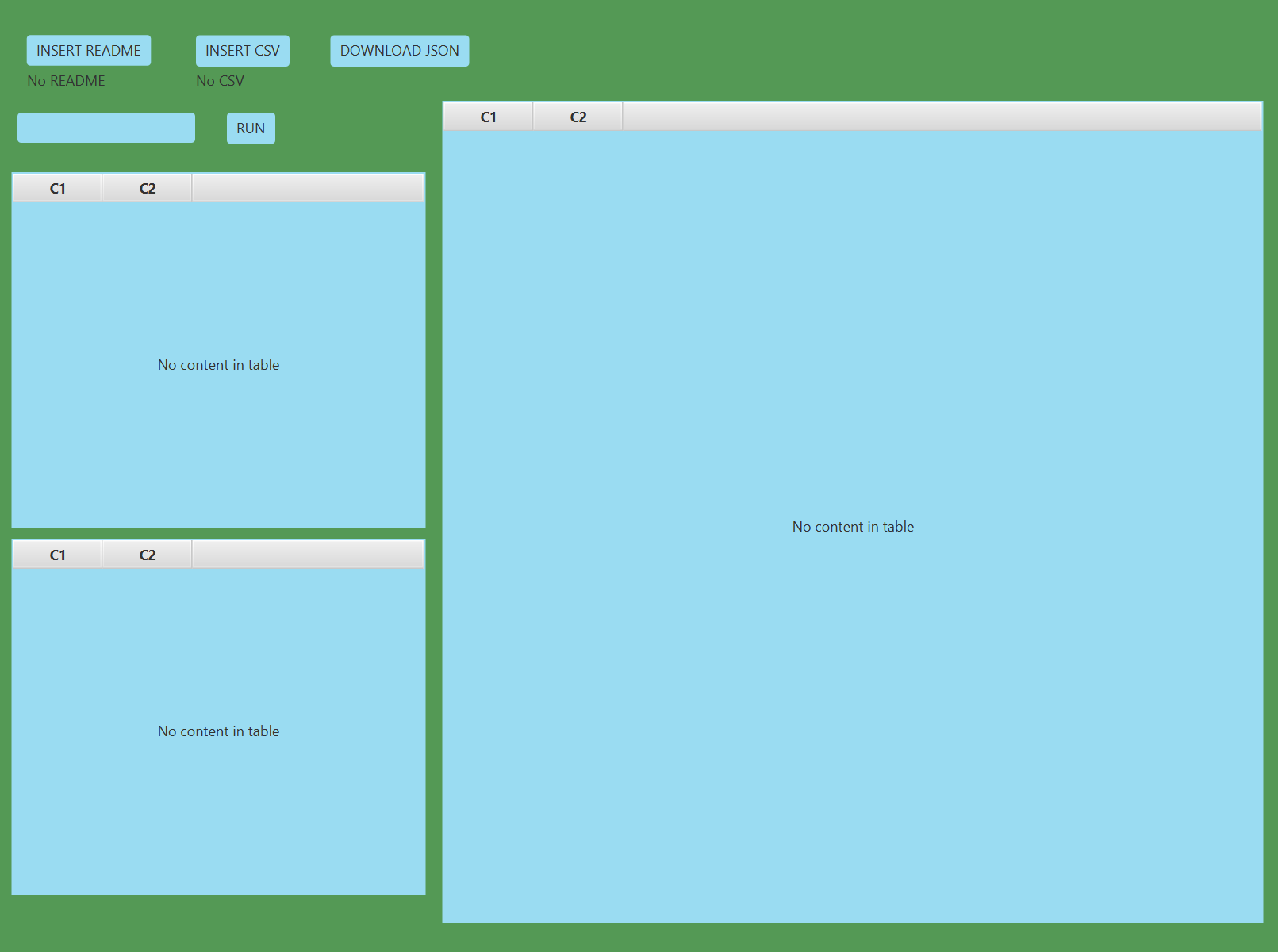
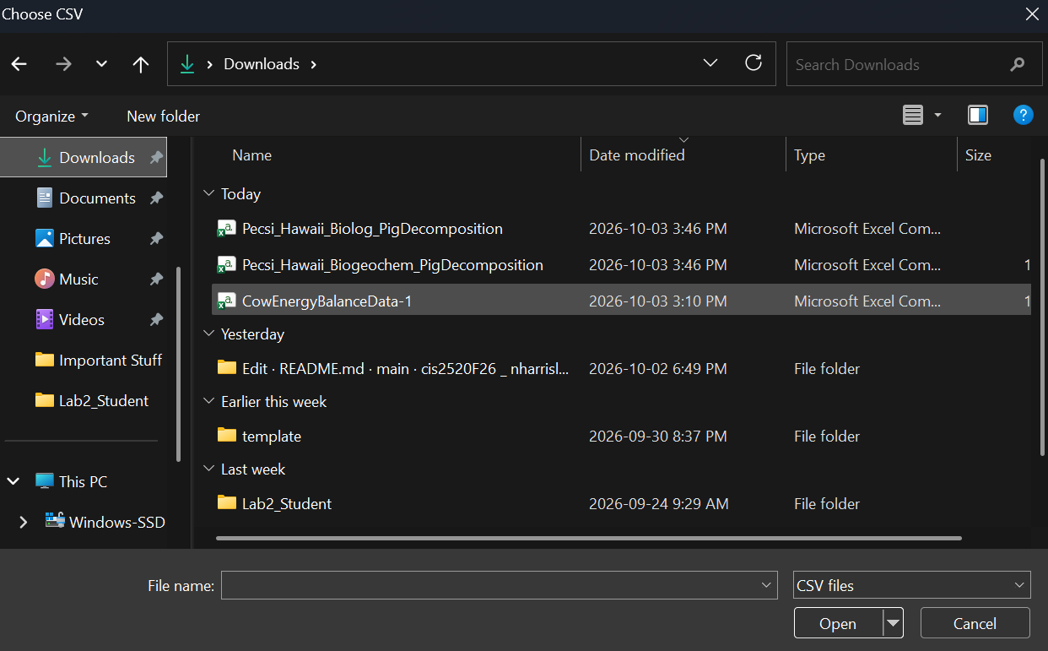
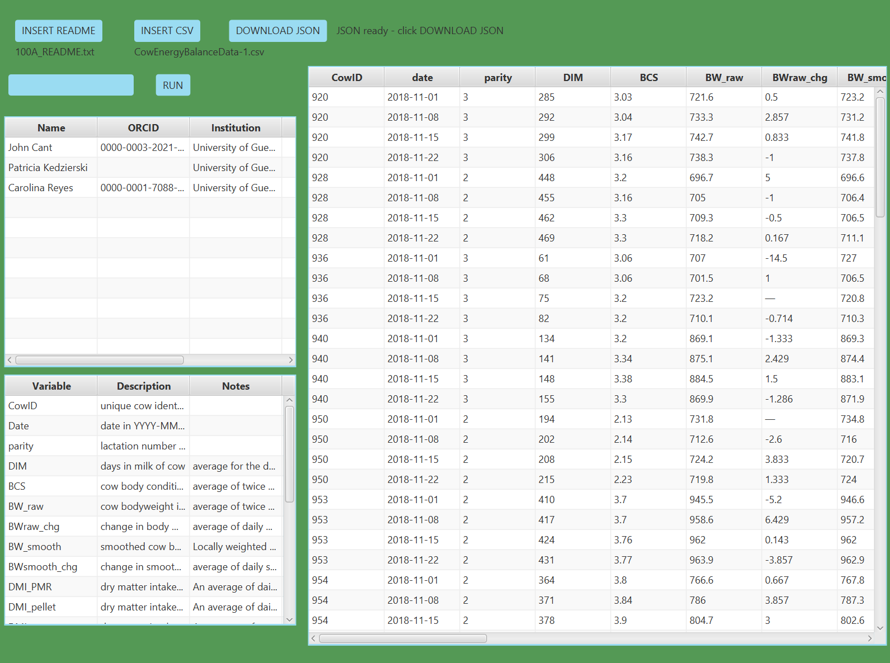
Our Program
Simple
Accessible
Organized
Select CSV and README files
Data is displayed
Download JSON
Select Files
Run Program

Slide 5
DEMONSTRATION

Slide 6
Implementation
Organizes different data types (CSV, txt)
Mass data accessible in one easy, organized GUI

Slide 7
Challenges
Getting JavaFX to work
Correctly extracting data to a readable form
JSON file formatting

Slide 8
Future Plans
Extract all data
Display metadata cleanly
Language options (TTS, Translation)
Encryption for data protection
Accessibility tools for ease of access
Process more data types

Slide 9
The End
Thank You for Listening!

Slide 10
Questions

